Slide 1



ICTC Training program

Slide 2
Versioning
Version | Date de version | Auteur / Contributeurs | Nature des modifications
2.0 | 2017-06-09 | Julien Jézéquel-Bréard Bruno Joliveau | Diffusion initiale

Slide 3
Summing-up
Integrated Business Process with Odoo
Purchases
CRM
Suppliers
Manufacturing
Business Processes
Customers
Inventory
Sales
Human Resources
Accounting
Projects
Employees

Slide 4











Summing-up / ERP Modules
CRM
Sales
Purchases
Inventory
Sales team Management
Customer Management
Lead Management
Opportunities Management
Help Desk & Support
Quotation Management
Order Management
Invoice Management
Products & Pricing Management
Purchasing Management
Replenishment
Supplier Management
Products / Services Management
Inventory Management
Logistics – In & Out Bound
Stock Allocation
Warehouse & Locations Management
Manufacturing
Accounting
Projects
Human Resources
Production Order
Bill of Material
Routing
Quality & Maintenance
Lean Manufacturing
Account Receivables
Account Payables
Bank & Cash Management
Business Analytics
Set taxes
Analitic Accounting
Budget & Forecast
Business Strategy
Ressource & Capacity Planning
Executive Dashboard & Control
Key Projects Metrics
Timesheet & Activity tracking
Expense Management
Recruitment
Employees
Performance Management
Compensation
Training & Development
Attendance & Leaves
Expenses

Slide 5
Accounting Management

Slide 6
Outcomes
Prepare and process bills, invoices, accounts payable and receivables,
Manage accounting information for activity and process,
Manage cost and revenu,
Measure organizational and operational performance over the Entire Value Chain,
Planning, budgeting, and forescating,
Manage taxation,
Evaluate and prepare managerial accounting statements.

Slide 7
Summing-up / ERP Modules
CRM
Sales
Purchases
Inventory
Sales team Management
Customer Management
Lead Management
Opportunities Management
Help Desk & Support
Quotation Management
Order Management
Invoice Management
Products & Pricing Management
Purchasing Management
Replenishment
Supplier Management
Products / Services Management
Inventory Management
Logistics – In & Out Bound
Stock Allocation
Warehouse & Locations Management
Manufacturing
Accounting
Projects
Human Resources
Production Order
Bill of Material
Routing
Quality & Maintenance
Lean Manufacturing
Account Receivables
Account Payables
Bank & Cash Management
Business Analytics
Set taxes
Analitic Accounting
Budget & Forecast
Business Strategy
Ressource & Capacity Planning
Executive Dashboard & Control
Key Projects Metrics
Timesheet & Activity tracking
Expense Management
Recruitment
Employees
Performance Management
Compensation
Training & Development
Attendance & Leaves
Expenses

Slide 8
Accounting Strategies
Strategies and Management Accounting
1. Planning & Configuration
2. Operation
3. Performance
Finantial Indicators
Performance KPI
Maximization Tools
Tax Logics
Multi-currency challenges
Payment conditions and agreements
Chart of accounts
Accounting Cycle
Budget Planning
Analytical Accounting
Journal Entries
Ledger Accounts
Trial Balance
Adjustment
Closing Account & Stock Valuation
Exceptions Management
(Partial Payment / Crédit note)
Expenses
Analytical Accounting Management

Slide 9
Accounting definitions
General Accounting (or Legal)
  Legal obligation, supported by the General Ledger for audit by controller
  The aim is to comply to legal obligation
  General accounting is not a tool to manage your business
Operational Accounting (or Analytical)
  Management accounting for directors comity, management and board
  The aim is to support and help business management and decisions
Other Accounting features (extra-accounting)
  Propose payment facilities (Customer credit, differed payment)
  It is not an obligation

Slide 10
Prerequisites and configuration
Accounts Chart
List of account you will use to register general accountability movements
Defined for each country
Journals
Document in which you will input daily accountable operations
Mandatory document, legal obligation
Listing and grouping your operations : Sales journal, Negative Sales Journal
Invoicing workflow for products
Control Purchase Bill and Invoicing Policy
In the product form, invoice on ordered quantities or received / delivered quantities
Accounts to use in products
Accounting tab : Income (sale) and expense (purchase) account to define
Price difference account

Slide 11
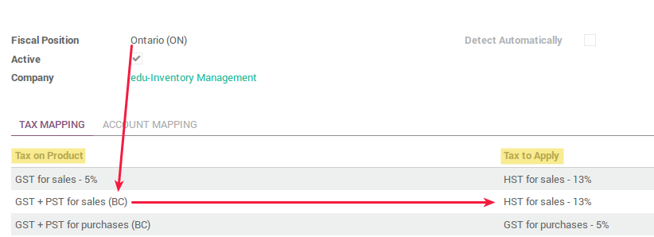
Prerequisites and configuration
Product Category : Accounts to define
In product form : Inventory tab : Internal category to edit
Define Accounts for stock and stock moves valuation for the category
Define Accounts for income and expense
  If accounts are defined on the product form, these are used instead
Tax chart
Comes by default with Account Chart
May be adjust according to specific needs (Tax exoneration to be identified, or Tax included article)
Fiscal position (Tax and Account mapping)
Fiscal position is set up onto your company, clients and suppliers
Allows to detect and apply automatically the applicable tax according to fiscal position
In each fiscal position, define the tax to use for each possible tax for the applicable fiscal position. Same with accounts.

Slide 12
Accounting
Core Process
Features
Account Receivables
Customer Invoices
Customer Payments
Account Payables
Supplier Bills
Pay supplier bills
Employee Expenses
Bank & Cash
Cash Management
Bank Management
Transfers
Multi-Currency
Miscellaneous
Business Analytics
Set taxes
Budget & Forecast
Reporting
Analytic Accounting
Average Cost & Inventory Valuation

Slide 13





Accounting – Overview
Invoices & Credit Notes Management / Bill vendors & Payments
Journal Entries & Ledger Accounts Management
Preparation & Monitoring of Budgets
Financial Statements
Cost Centre Analysis (Analytic Accounting)

Slide 14

Accounting Cycle
1
2
3
4
5
6
7
8
Transactions /
Source document
Journal Entries
Posting
Trial Balance
Worksheet
Adjusting Journal Entries
Financial Statements
Closing the Books

Slide 15
Accounting
Revenue Cycle
Payment Cycle
Adjusting
Journal
Entries
General
Journal
Sales
Invoice
Sales
Journal
Purchases
Journal
Supplier’s
Invoice
Accounts
Receivable
Listing
General
Ledger
Accounts
Payable
Listing
Deposit
Slip
Cash/Checks
Receipt
Journal
Cash/Check
Disbursement
Check
Finantial
Statement

Slide 16
Accounting – Payment Terms
Payments can be set on:
For Customers
For Vendor Bills
A customer: to apply payment terms automatically on new sale orders or invoices for customers.
A quotation: to apply payment terms on all invoices created from quotation or sale order, but not on order quotation.
An invoice: to apply payment terms on invoices only
To manage payment terms for vendor bills just the due date is enough.
Use payment terms exactly like in customer invoices, to manage vendor terms with several installments.
Not due date if you set a payment term on the vendor bill.

Slide 17
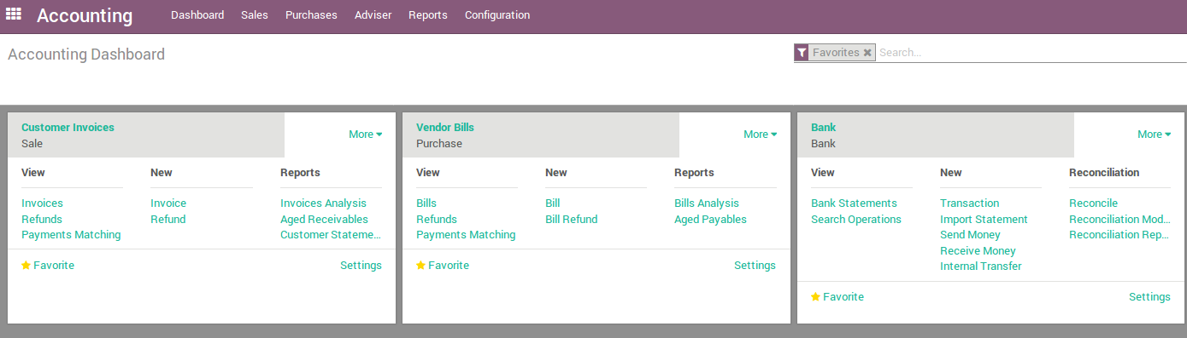
Accounting Dashboard
Understanding the accounting dashboard in Odoo :
Click more to get the extended menu
1
Batch matching of payments, invoices and vendor bills

Slide 18
Account Receivables

Slide 19
From Invoice to Payment Collection
Draft invoice
Open or Pro-forma invoices
Send the invoice to customer
Payment (Full / Partial payment)
Reconcile
Payment Follow-up
Profits & Loss
Balance Sheet
Reporting
Validation of draft invoice
Associated accounting entry has been reconcilied with the payment entries
Follow-up strategy / Customer aging report
Income statement or Statement of Revenues and Expenses
Summarize the company’s liabilities assets and equity

Slide 20
WARNING
The following exercises are designed for a specific business case (see CRM training support on https://github.com/savoirfairelinux/training-odoo), for a single company, and single currency business context.
Following scenarios exclude every case of para-fiscal tax, and multi-currencies cases, which would take a lot more work to configure the system.

Slide 21
Exercise : Standard payments registration
15 min
Full payment tied to an invoice
TO DO
Create a sale Order, from Sales module.
Client : Arts Bapista, Article : Korazar#1 (White), Qty : 10 gals. Note your SO number.
Confirm the sale and create the invoice from the SO form ([Create Invoice] button). Select ‘Invoiceable lines (deduct down payments)’.
Go to the Accounting module, on your Dashboard, in the Customer invoices pad, you have an invoice to validate. Click it.
From the Invoice form, validate the Invoice, and Register Payment. Select Bank.
Validate. Your invoice has been updated with payment date and payed amount.

Slide 22
Exercise : Partial payments registration
15 min
Multiple partial payments tied to an invoice
Duplicate the SO you have just created.
Confirm the sale and create the invoice from the SO form ([Create Invoice] button). Select ‘Invoiceable lines (deduct down payments)’.
Go to the Accounting module, on your Dashboard, in the Customer invoices pad, access the invoice and validate it.
From the Invoice form, click Register Payment (select Bank).
The amount paid is 80 $ CAD. Tick Keep open so that you can register others payments on the Invoice.
Your invoice has been updated with payment date, payed amount and the amount due.
Complete with another payment to close the Invoice.

Slide 23
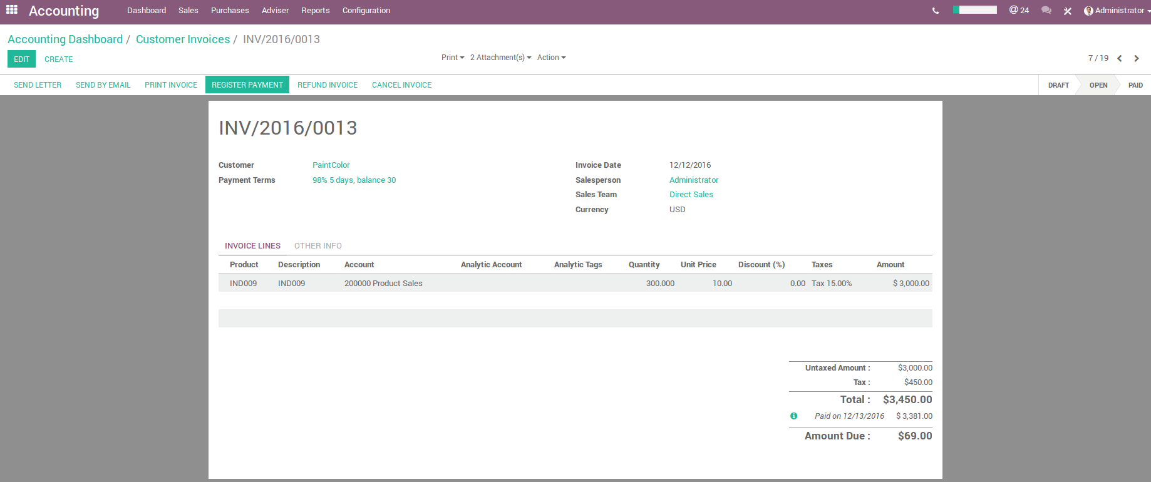
Accounting – Registering multiple payments
Paying an invoice
The payment is automatically reconciled with the invoice reducing the amount due.
Multiple payments linked to the same invoice.

Slide 24
Exercise : Uncomplete payment
15 min
Uncomplete payments tied to an invoice
Case : You have sold products to your client and he has sent you a payment with an insignificant difference of amount. You want to register the payment and close the bill.
Duplicate the SO you have just created.
Confirm the sale and create the invoice from the SO form. Select ‘Invoiceable lines (deduct down payments)’.
Go to the Accounting module, on your Dashboard, in the Customer invoices pad, you have an invoice to validate. Click it.
On the Invoice form, register a payment (Bank) of 135 $ (of 135.60). Select Mark invoice as fully paid, and select the account Undistributed Profit/Losses.

Slide 25
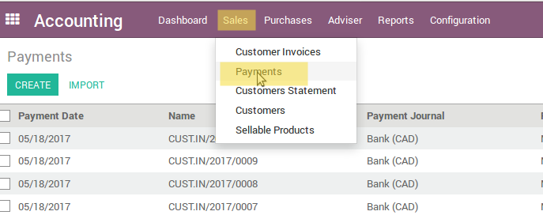
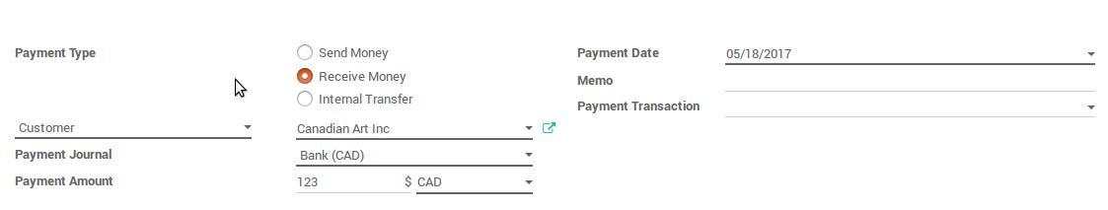
Registering payment not linked to an invoice

Slide 26
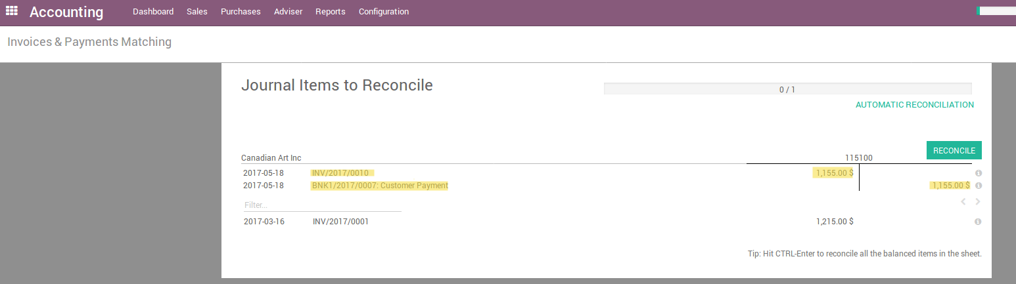
Exercise : Registering payments
30 min
Payments not tied to an invoice
TO DO
Create a new payment from Accounting module, Sales drop down list (register a payment). Amount = 1155 $. Type = Receive money.
Although the payment is not linked to an invoice, it can easily be reconciled on an invoice later on.
Create a SO from Sales modules : Client = Canadian Arts, Article = Intervinyl#1 (White), Qty = 100. Confirm Sales and create Invoice. Amount should be 1155 $.
Go to Accounting module and click ‘Manual payments and Invoices matching’ in Adviser drop down list. Process the reconciliation.

Slide 27
Exercise : Refund payment
30 min
Paid invoice to refund because of a product return
TO DO
In Sales module, take one of the Sale order you have created (or create a new one) and create the invoice. Register the payment if not already done on the Invoice.
Go on the Invoice form, and click Refund Invoice
Select ‘Create draft refund’
Indicate the reason of the operation
Register the payment of the refund.

Slide 28
Exercise : Creating an invoice with a cash discount
30 min
Case Study – Customer Paintcolor
Canadian Colors offer a 2% discount on an invoice due in 30 days if the customer Paintcolor were to pay within the first 5 days of receiving the invoice.
Configuration Management Payment Terms Create
TO DO
Configure the payment term in Accounting > Configuration > Payment terms
Create a model of entry for all cash discounts - To do that, from the Accounting application dashboard, click on the "More" link on the bank and choose the option "Reconciliation Models".
Create a new Sale order (select the payment term right after having selected the client) and process the payment

Slide 29
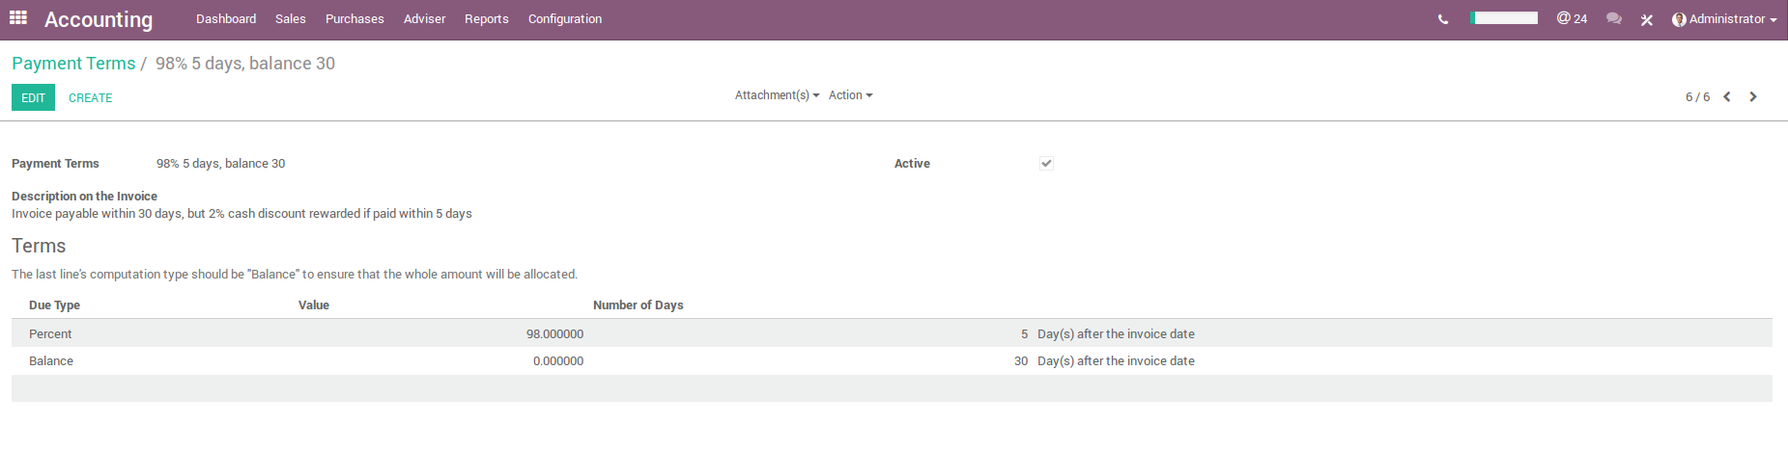
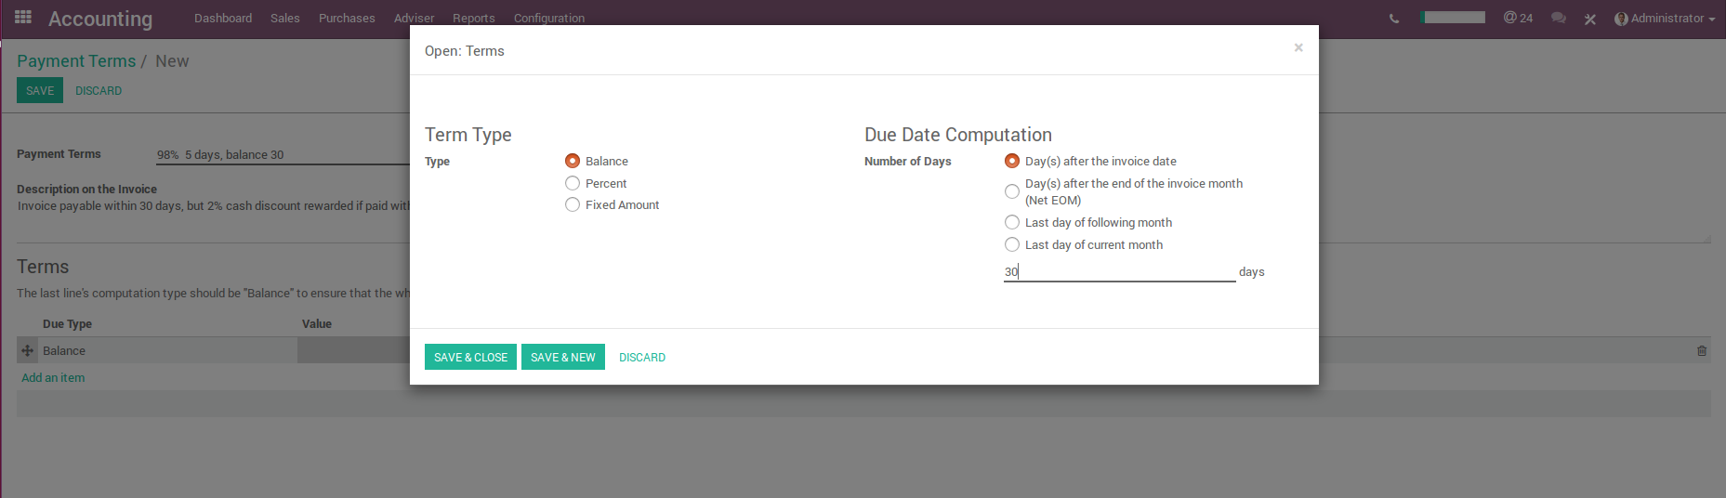
Accounting - Payment terms

Slide 30
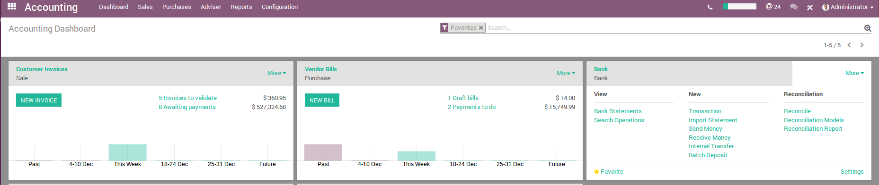
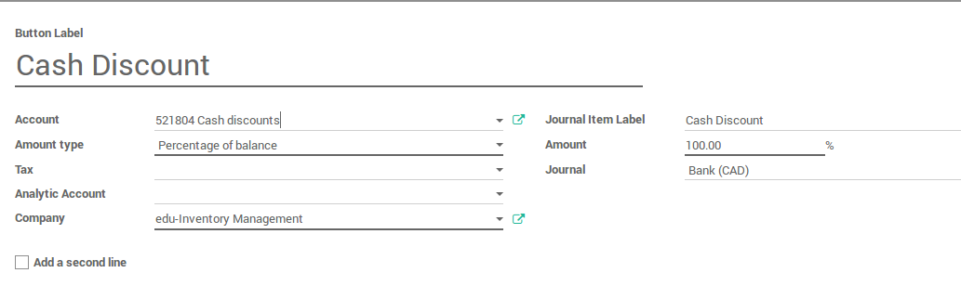
Accounting - Payment discounts

Slide 31
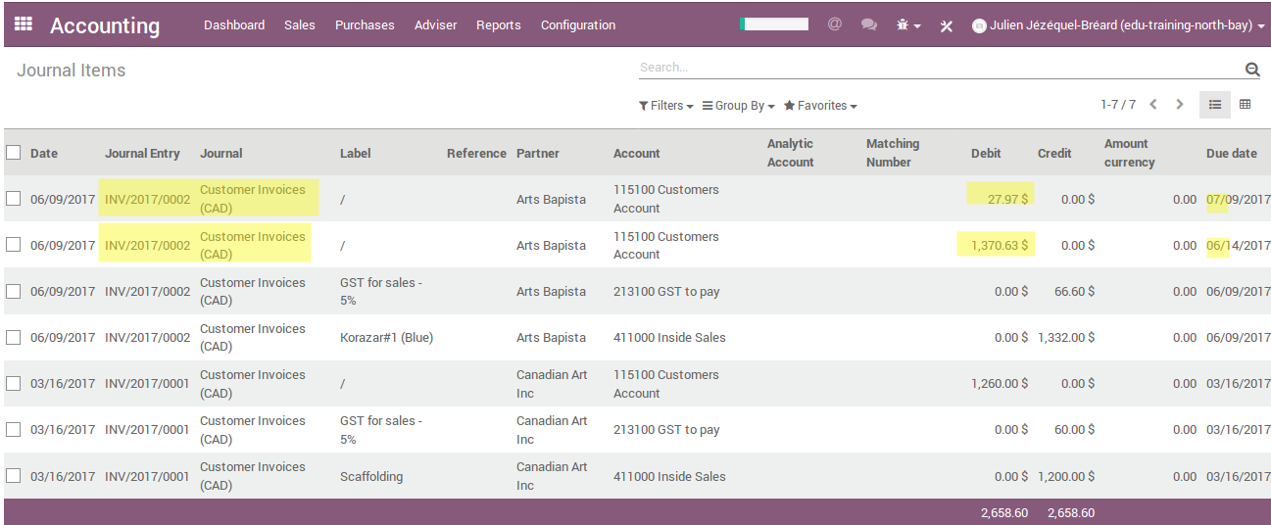
Accounting - Payment discounts
Once you have created your invoice with this payment term, you can verify in the Journal items list (Accounting > Avdiser) that you have 2 different lines for your Invoice, with 2 different due dates.

Slide 32
Accounting - Payment discounts

Slide 33
Account Payables

Slide 34
From Vendor Bill to Payments
Record a new Vendor Bill
Validate the Vendor Bill
Pay a Bill
Reporting
Purchases – Vendor Bills
Account Payables / Taxes / Goods Received
Payment Method / Printing Vendor Checks
Aged payable balance / Business Statement / Aged Payable

Slide 35
Exercise : Pay several bills with one payment
30 min
Canadian Colors purchase inputs for production like plastic paint containers from the supplier « Multiplastic ».
Due to the capacity of this supplier, he provides products from two regions of Canada: Ontario and Quebec.
Canadian Colors will buy 10.000 and 5.000 units for its production of Ontario and Quebec respectively.
Simulate different taxes for these two regions. Ontario - Tax 8% and Quebec 15%.
Payment agreement of 15 days after receiving the goods.
TO DO
Register two purchase orders of supplies for this same supplier
Create Vendors Bills
Pay these bills with one payment and altogether

Slide 36
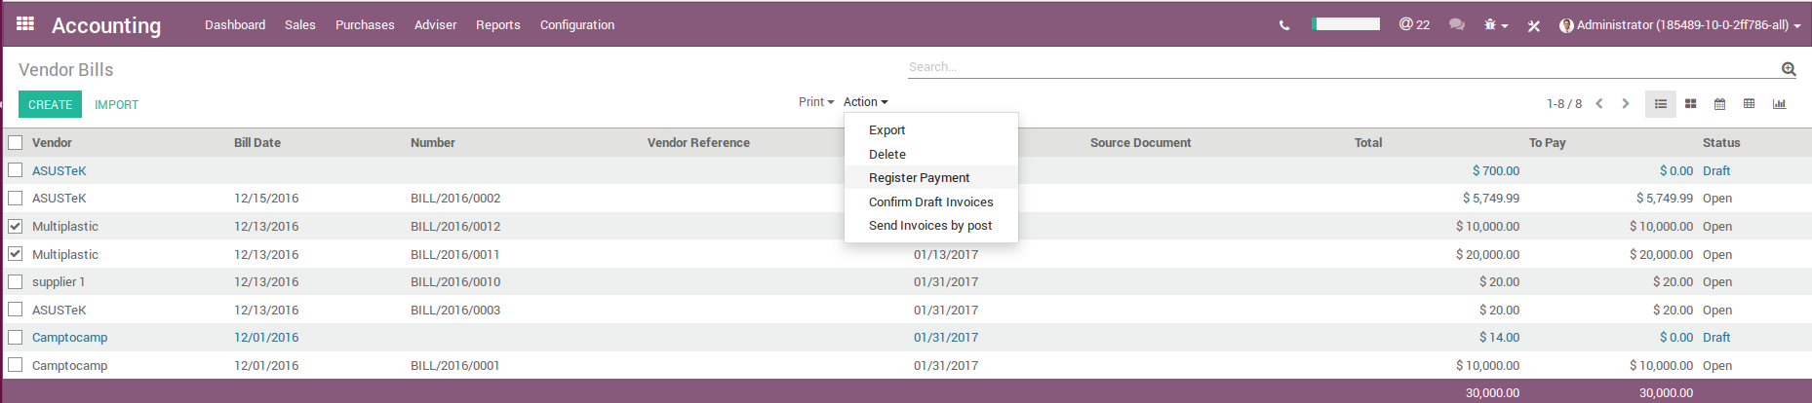
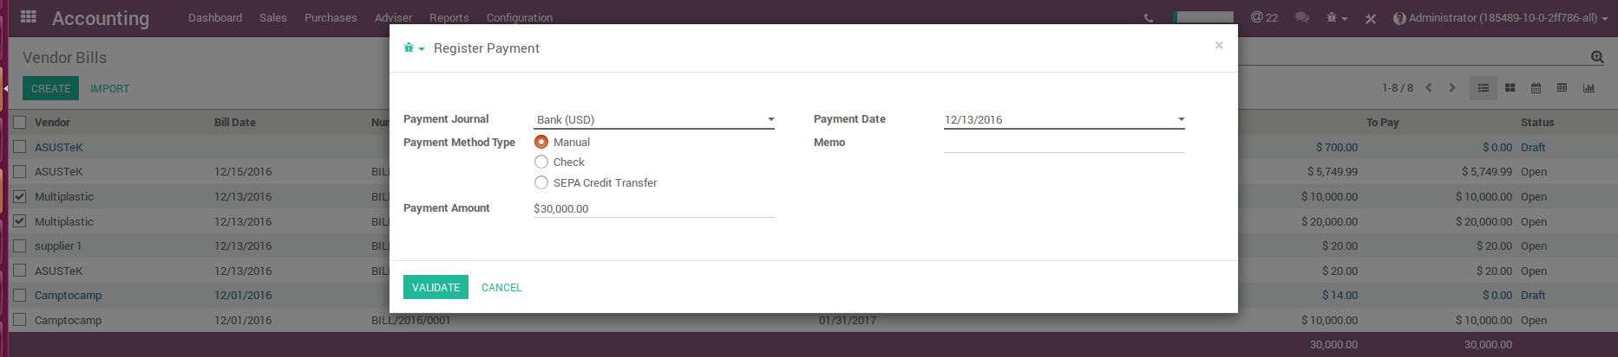
Accounting – Register payment

Slide 37
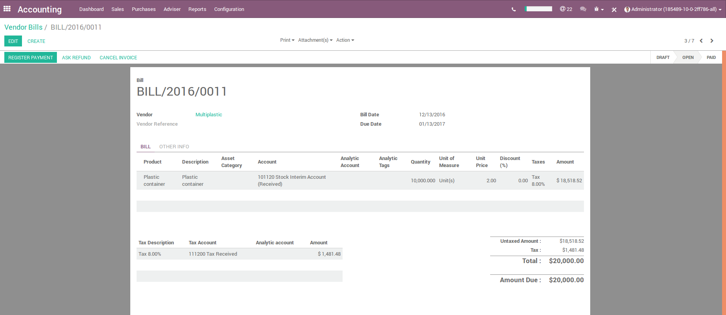
Accounting – Tax-Included Prices
Vendor Bill example with taxes included in price
Using this option, the invoice is paid and the reconciliation is done automatically

Slide 38
Exercise : Register TAXI product to manage your employees expenses
30 min
This exercise is designed for the specific purpose of Accountability, but Odoo offers a specific module to manage expenses
Canadian Colors wants to register a TAXI product in its system so that employees can register their expenses with the according product for Tips.
Create a new product named ‘Taxi’, this product can only be purchased.
Go to the Accounting module, find the applicable tax in Ontario
Create a new tax-included tax by duplicating the existing one, and adjust it accordingly

Slide 39
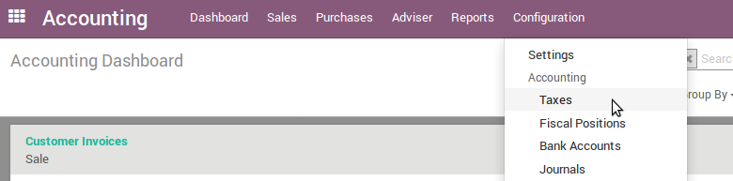
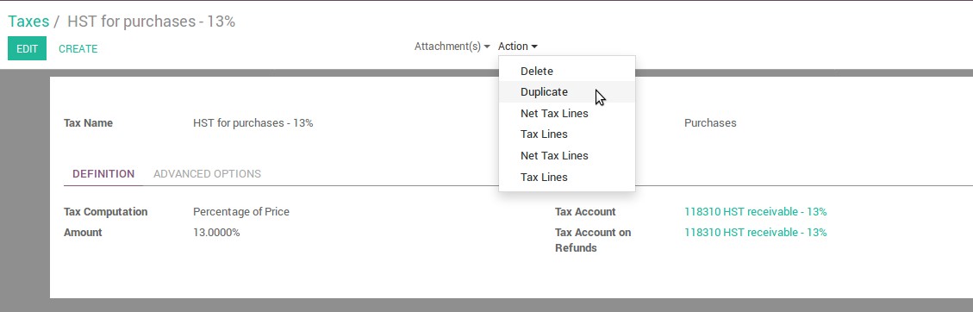
Create a new tax for tax-included

Slide 40
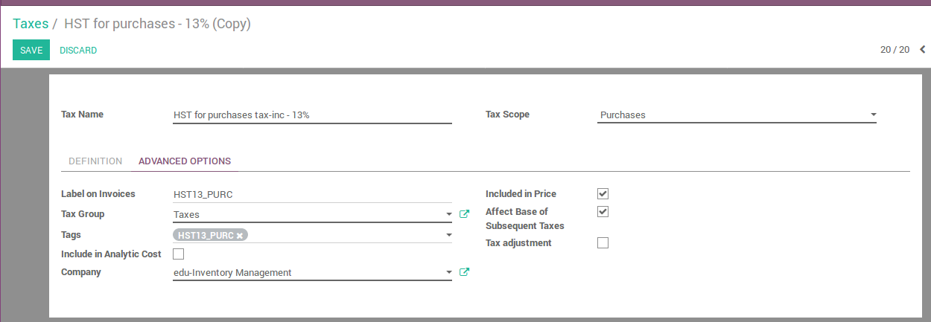
Set a tax-included tax
Rename your tax to easily identify it, and tick ‘Included in price’

Slide 41
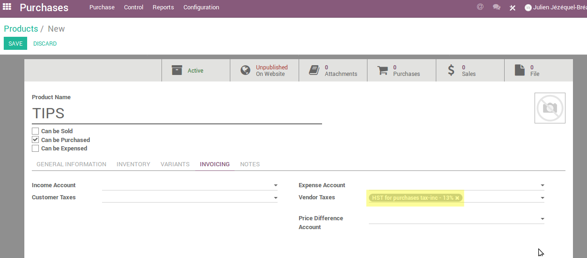
Set a tax-included product

Slide 42
Analytic Accounting

Slide 43
Analytic Accounting
The analytic accounting can be used for several purposes :
Analyse costs of a company
Reinvoice spent time to a customer
Analyse performance of a service or a project

Slide 44
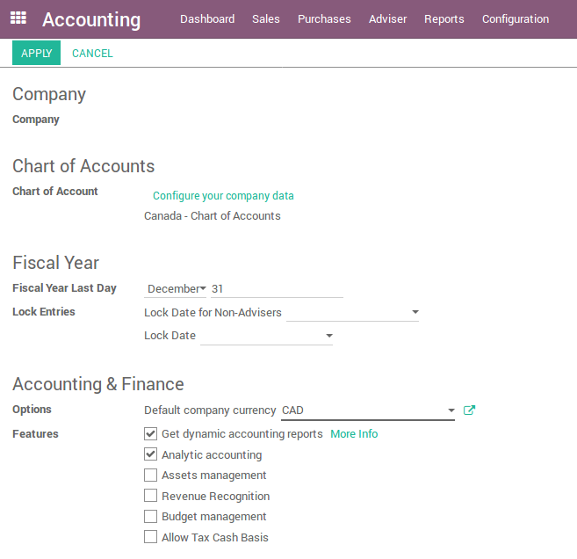
Analytic Accounting
To manage analytical accounting, you have to activate it in :
Configuration Settings

Slide 45
Case : Costs Analyse
Canadian Colors Inc. has analytic charts of accounts structured into departments and products which the company itself is built on.
Te objective is to examine the costs, sales, and margins by department/resources and by product. The first level of the structure comprises the different departments, and the lower levels represent the product ranges the company makes and sells.
Analytic Chart of Accounts for Canadian Colors Inc. :
Marketing Department
Commercial Department
Administration Department
Paint Production Range
Agrochemical Production Range
Adhesive Production Range
Professional Tool Assembly Range
Rental Tool

Slide 46
Case : Costs Analyse
1
2
3
General Accounts
Mark the analytic account on purchase invoice
The invoice is approved
Generate the entries automatically
Analytic Accounts
Here is a possible breakdown of some general accounting entries for the example above, allocated to various analytic accounts :

Slide 47

Case : Costs Analyse
The analytic representation by department enables you to investigate the costs allocated to each department in the company. The analytic chart of accounts shows the distribution of the company’s costs using the example above :
Analytic Entries
+
+
-
-
-
+
+
+
-
+
+
+
-
+
+
+
-
In this example of a hierarchical structure in Odoo, you can analyse not only the costs od each product range but also the costs of the whole production.
+
+
-
+
+

Slide 48
Reporting

Slide 49
Accounting – Reporting
Generic and dynamic reports:
Balance Sheet (assets, liabilities and equity)
Profit & Loss Report (Income Statement)
Chart of Account (Accounts grouped by class)
Executive Summary
General Ledger Report (all transactions from all accounts for a chosen date range)
Aged Payable Details
Aged Receivable Report
Cash Flow Statement
Tax Report (tax grouped by type – sales/purchase)
Bank Reconciliation

Slide 50
Bonus exercise :
15 min
Generate 6 invoices with different payment terms and for 6 different customers
Find in the Acounting module :
    A way to have a view of due invoices grouped by due date
    Edit a pdf report of the aged balance of your receivables accounts (Aged receivables in Adviser)

Slide 51
Questions?

Slide 52
Contributions
This document has been authored and distributed by the functional team of Odoo, Savoir-faire Linux :
Carolandrea Guerrero
Mickaël Brard
Marc Lijour
Julien Jézéquel-Bréard
Bruno Joliveau
Quentin Lavallée
Adriana Ierfino
Guillaume Lot
You can download this training document, use and modify it (within diposals and limits of the applicable licence CC-BY-NC-SA), at the following url : https://github.com/savoirfairelinux/training-odoo

Slide 53

IT Management Solutions

